Slide 1





Pythons ‘R’ Us
Christian
Bourdeau
PJ
Villasista
Jason
Vo
Alexander
Resendiz
Hunter
Vazirian

Slide 2
PROBLEM STATEMENT
Design a dashboard that showcases leading Yelp businesses in each category on an interactive map based on a ranking algorithm that utilizes ratings, review frequency, and review sentiment

Slide 3
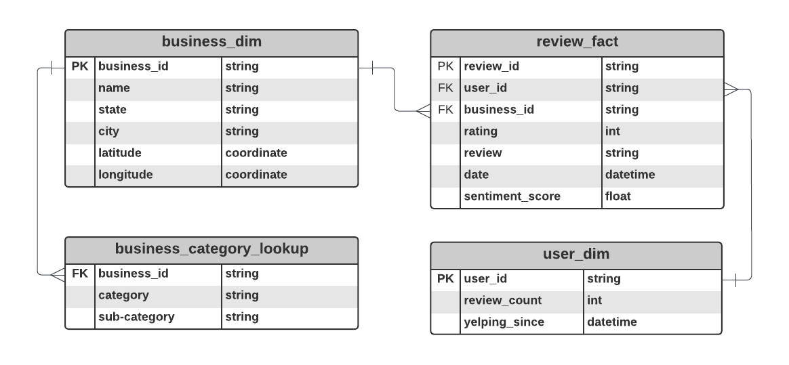
SOLUTION APPROACH
Entity Relationship Diagram
Collect Data & Clean
Conduct Sentiment Analysis
Create Business Ranking Algorithm
Visualize Findings
Algorithm
# Constants to adjust the relative importance of each factor
0.3 * MIN(review_count / 100, 1) + # review_weight * normalized_num_reviews
0.4 * (AVG(rating]) - 1) / 4 + # rating_weight * normalized_rating
0.4 * (AVG(sentiment_score) + 1) / 2 # sentiment_weight * normalized_sentiment_score
Tech Stack: Python - NLTK, SpaCy, TextBlob, Pandas, OpenAI API, Yelp API; Tableau

Slide 4
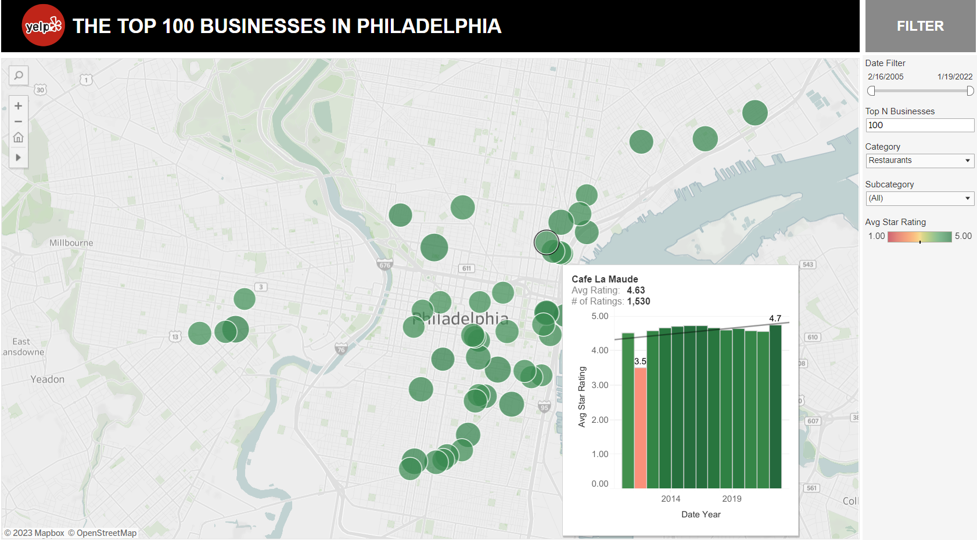
INTERACT WITH OUR WEB APP HERE: bit.ly/python-r-us

